Slide 1

Design Genie
Introduction
An AI-powered web application that generates optimized design suggestions for architecture, product design, and prototyping
Key Features
Input constraints
AI-based design generation
Regeneration and export options
User-friendly interface

Slide 2
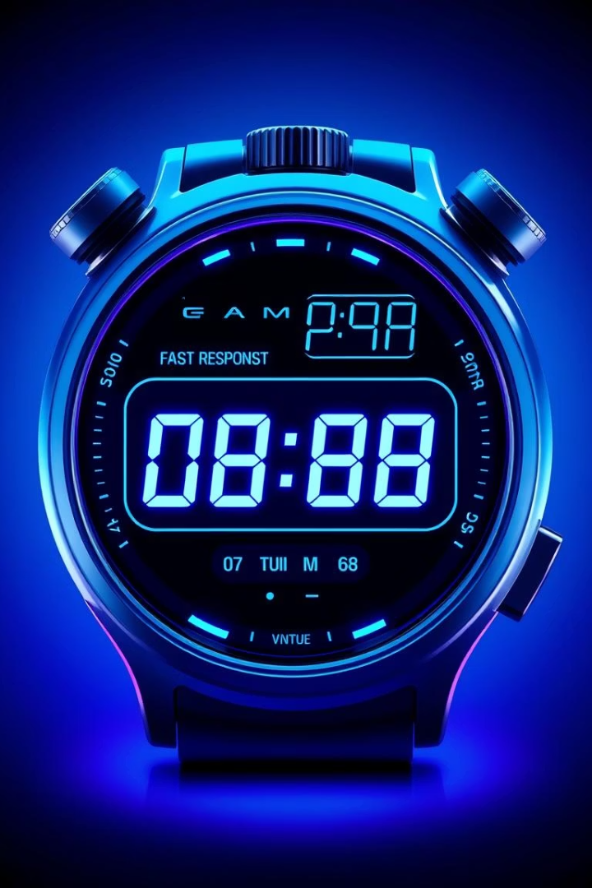

Non-Functional Requirements
Usability:
Intuitive UI with clear navigation and input validation
Maintainability:
Modular MVC structure allows easy updates and expansion

Slide 3
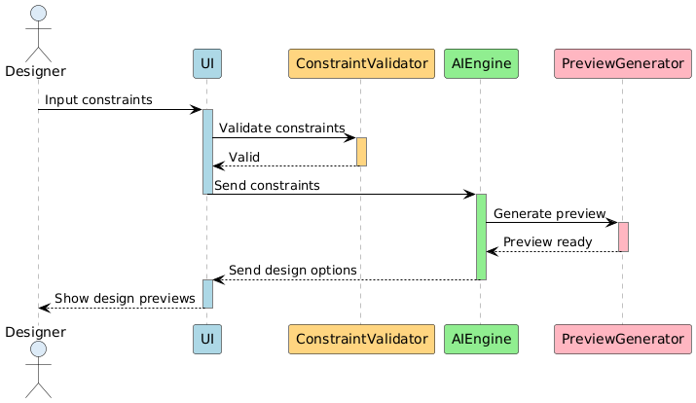
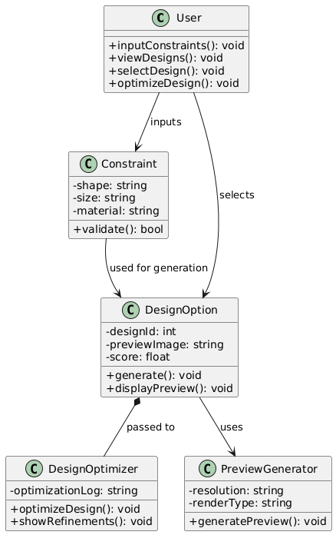
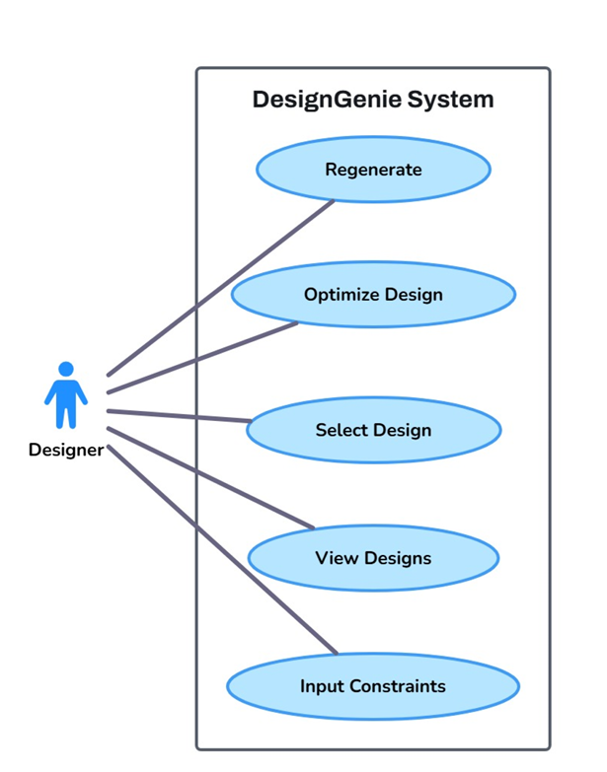
Design Overview
Sequence Diagram
Class Diagram
Use Case Diagram

Slide 4
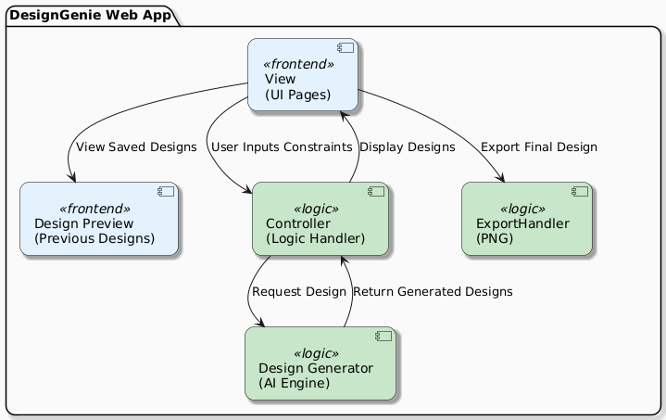
Architecture
Model-View-Controller (MVC) Structure
Model
Handles design constraint data and contains the AI-based logic to generate
, optimize, and regenerate designs.
View
The graphical user interface (GUI) where users select categories, enter constraints, and view/download generated designs.
Controller:
Acts as the intermediary between user actions and the AI logic. It
processes inputs, triggers the design generation, and updates the UI accordingly

Slide 5
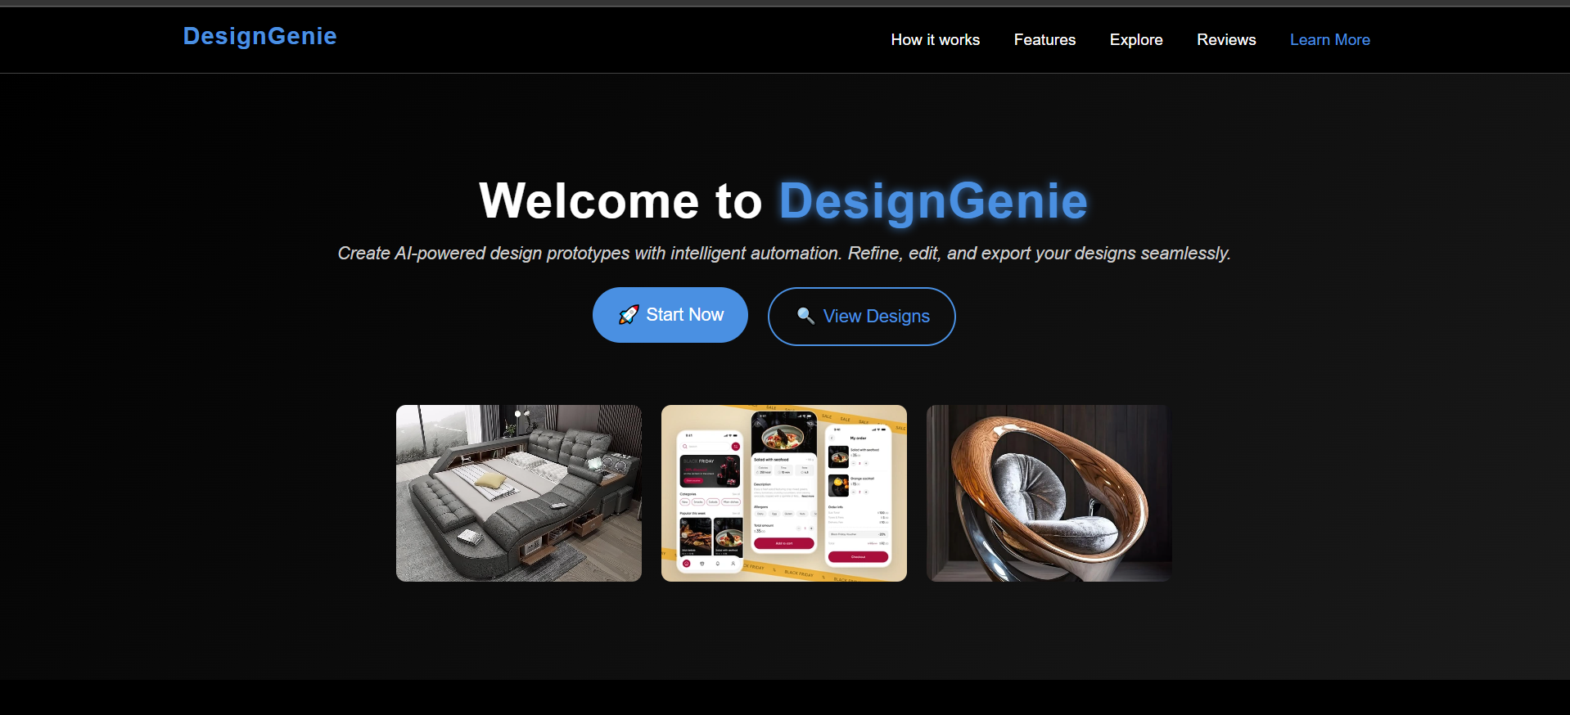
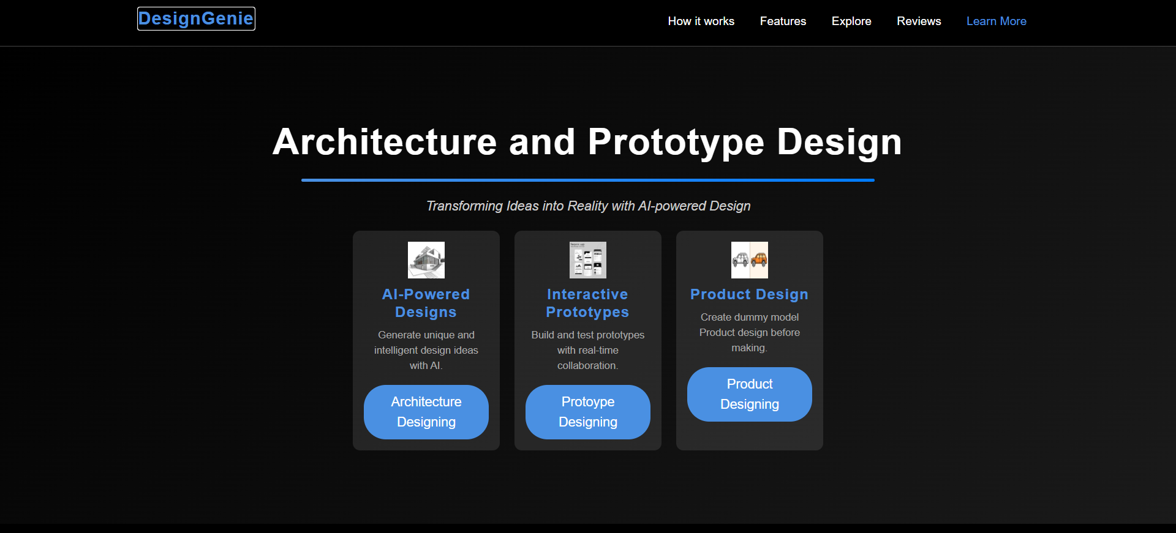
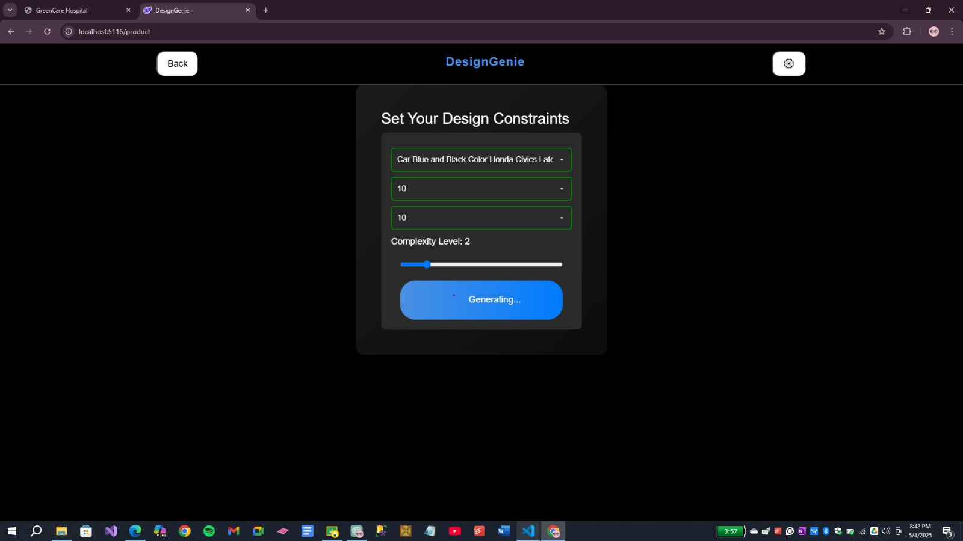
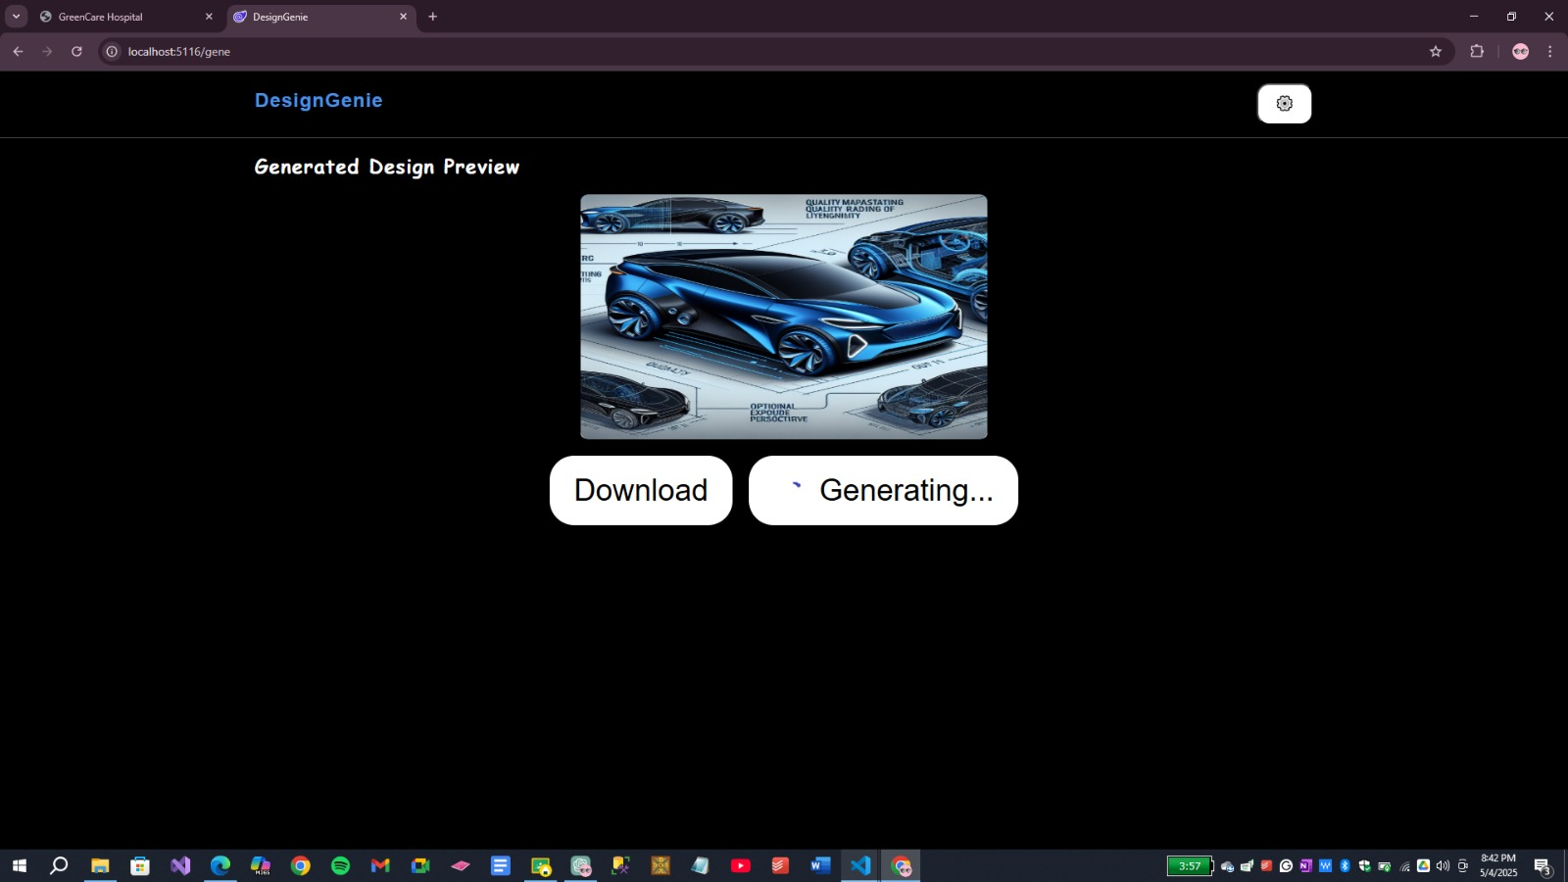
Actual Implementation Highlights
Dashboard
Intuitive interface for efficient design management and monitoring.
Real-time analytics to track user engagement and AI-generated suggestions.
The dashboard acts as a central hub, offering quick and easy access to essential features. It boosts user productivity by consolidating design data and AI outputs in a single, streamlined view.

Slide 6
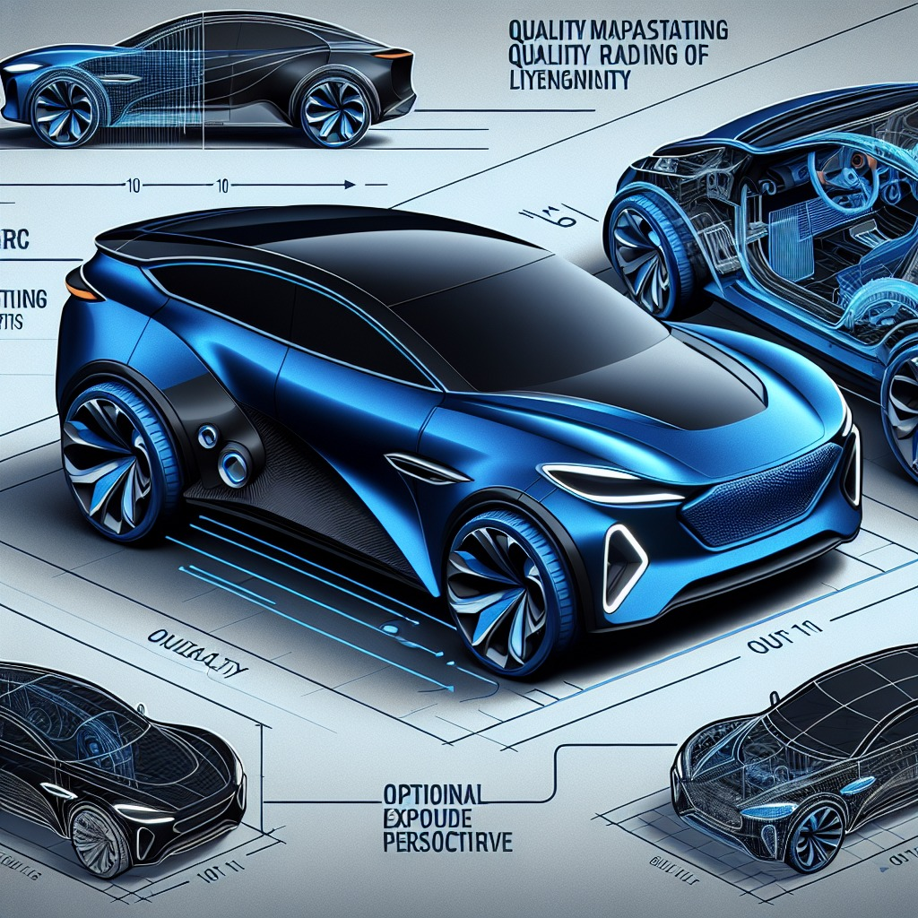
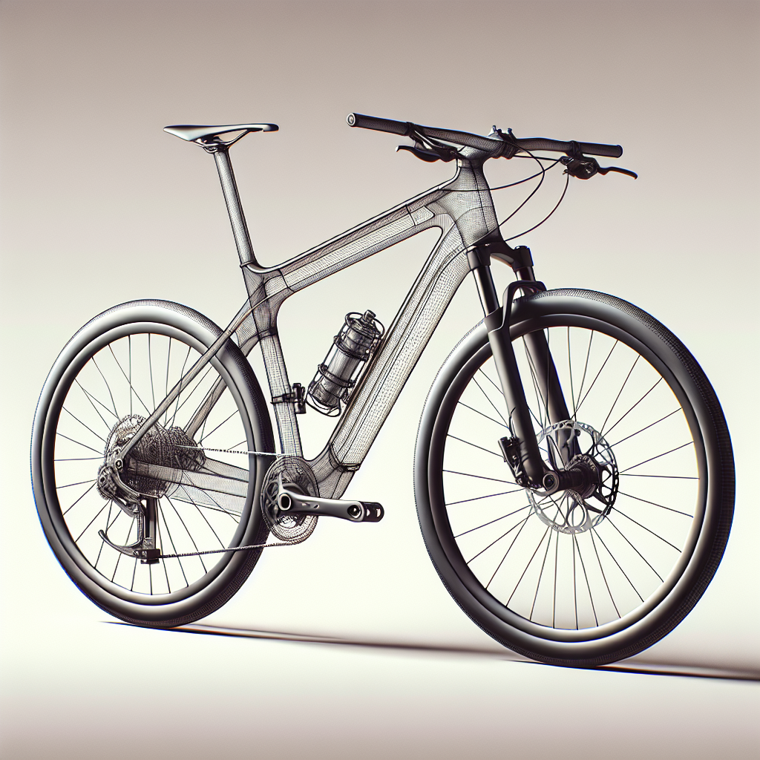
Generated Designs

Slide 7

Advantages and Constraints
Advantages
Accelerates design processes by enhancing workflow speed and fostering creativity.
Decreases overall costs associated with design tasks.
Promotes generation of innovative user-driven content.
Constraints
Highly dependent on the accuracy of AI algorithms.
Requires robust measures to protect sensitive user information.
Integration with existing tools presents significant complexity.

Slide 8
Work Division & Lessons Learned
Team Roles & Responsibilities
Key Lessons Learned
Urwa Khalid: Backend development and AI logic implementation
Applying boundary value analysis enhanced testing precision.
Faryal Zahra: UI/UX design and validation
Adopting a modular (MVC) architecture simplified scaling and maintained clean code.
Areeba Noor: Quality assurance, testing, and documentation
Incorporating regeneration features increased user flexibility.
Utilizing an Agile workflow facilitated clear responsibilities and fostered open feedback.
Using project management tools like Trello optimized team coordination.
Prioritizing strong UI/UX directly contributed to improved user satisfaction.

